Slide 1
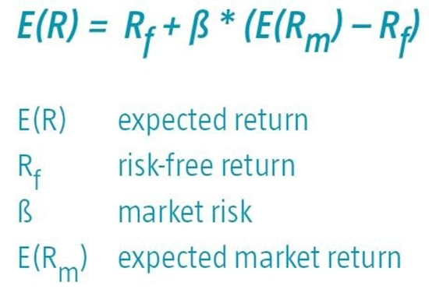
Lecture 9: Capital Asset Pricing Model
HE Tai-Sen
FINANCIAL ECONOMICS

Slide 2
Capital Asset Pricing Model
Outline
CAPM (9.1)
Assumptions
Result 1: Market portfolio (M)
Result 2: Capital market line (CML)
Result 3: Risk-premium on the market portfolio
Result 4: Risk-premium on individual assets and SML (security market line)
Notes:
https://www.nobelprize.org/nobel_prizes/economic-sciences/laureates/1990/presentation-speech.html
Portfolio theory analyzes the decision-making problems of an individual portfolio manager. For this reason, the market price of various assets is regarded as given. The next step in the analysis is to explain how these asset prices are determined. This was achieved by development of the so-called Capital Asset Pricing Model, or CAPM. It is for this contribution that William Sharpe has been awarded. The CAPM shows that the optimum risk portfolio of a financial investor depends only on the portfolio manager's prediction about the prospects of different assets, not on his own risk preferences. The model also shows how risks can be bought and sold, and hence how risks can be spread via capital markets.

Slide 3
Capital Asset Pricing Model
Assumptions
Assumptions of the CAPM:
Many investors: each with an endowment(wealth) that is small compared to the total endowment of all investors. Investors are price-takers. Investors only differ in their risk aversion and initial endowment (no investor is endowed with the risk-free asset).
One identical holding period
Investments are limited to publicly available financial assets (such as stocks, bonds and risk-free borrowing or lending arrangements). This assumption rules out investment in nontraded assets such as education and private enterprises.
No taxes
All investors are rational mean-variance optimizers (risk-averse).
Homogeneous expectations/beliefs: all investors analyze securities in the same way and share the same economic view of the world.
In equilibrium, all markets clear (demand = supply). That is, we will find a set of prices such that the demand for each stock is equal to its supply (endowment).

Slide 4
Capital Asset Pricing Model
Result 1: Market Portfolio (M)
Result 1: Market portfolio (M)
All investors will choose to hold a portfolio of risky assets in proportions that duplicate representation of the assets in the market portfolio (M), which includes all traded assets.
For simplicity, we generally refer to all risky assets as stocks. The proportion of each stock in the market portfolio equals the market value of the stock divided by the total market value of all stocks.

Slide 5
Capital Asset Pricing Model
Result 1: Market Portfolio (M)
Rationale behind Result 1: If all investors use identical Markowitz analysis applied to the same universe of securities for the same time horizon and use the same input list, they all must arrive at the same composition of the optimal risky portfolio.
Why does the market portfolio include all traded assets? Suppose Stock A is not included in M. When all investors avoid Stock A, the demand is zero and the stock price will fall. As Stock A gets cheaper, it becomes more attractive. Ultimately, Stock A reaches a price where it is attractive enough to include in the optimal risky portfolio (the market portfolio).

Slide 6
Capital Asset Pricing Model
Result 2: Capital Market Line (CML)
Result 2: Capital market line (CML)
All investors hold M as their optimal risky portfolio, differing only in the amount invested in it versus in the risk-free asset.
E(r_{r})
Result 2 implies that investors do not need to engage in security selection. Instead, they only hold the market portfolio and the risk-free asset in their portfolio. That is, passive strategy is efficient.
CML
M
E(r_{m})
r_{f}
Std

Slide 7
Capital Asset Pricing Model
Result 3: Risk-Premium of The Market Portfolio
Result 3: Risk-premium on the market portfolio
The risk premium of the market portfolio will be proportional to its risk and the degree of risk aversion of the representative investor.
Risk premium of the market portfolio is equal to average degree of risk aversion * the variance of the market portfolio

Slide 8
Capital Asset Pricing Model
Result 3: Risk-Premium of The Market Portfolio
Rationale behind Result 3:
In the simplified CAPM economy, risk-free investments involve borrowing and lending among investors. Any borrowing position must be offset by the lending position of the creditor. This means that net borrowing and lending across all investors must be zero.
Substituting the representative investor investor’s risk aversion for A, the average position in the risky portfolio is 100%. That is,

Slide 9
Capital Asset Pricing Model
Result 4: Risk-Premium on Individual Assets and Security Market Line
Result 4: Risk-premium on individual assets and SML (security market line)
The risk premium on individual asset will be proportional to the risk premium on the market portfolio, M, and the beta coefficient of the security relative to the market portfolio.
Proof
--- Security Market Line (SML)

Slide 10
Capital Asset Pricing Model
Result 4: Risk-Premium on Individual Assets and Security Market Line
Beta is a risk measure which measures how an individual stock co-moves with the market.
If a stock has a beta of 2, it implies that _____
The market portfolio’s beta = ____
Portfolio’s beta is the weighted average of each security’s beta.
Notes:
If the market increases by 1%, the stock would increase, on average, by 2%.
Market beta=1

Slide 11
Capital Asset Pricing Model
Result 4: Risk-Premium on Individual Assets and Security Market Line
Security market line (SML)
E(r_{i})
Q1 : Why positively sloped?
SML
Q2: Why should investors only expect to be compensated for systematic risk?
E(r_{m})
r_{f}
1
beta

Slide 12
Capital Asset Pricing Model
CAPM in Security Analysis
Application of CAPM in Security Analysis
Applying CAPM to identify undervalued and overvalued assets
Alpha = (actual expected rate of return)-(expected rate of return based on its beta). The difference between the fair and actual expected rates of return on a stock.
If Alpha>0, then the stock is undervalued. => BUY
If Alpha<0, then the stock is overvalued. => SELL

Slide 13

Capital Asset Pricing Model
CAPM in Business Valuation
Application of CAPM in Business Valuation
The market capitalization rate can be estimated using CAPM:
Example: Please calculate stock ABC’s market capitalization rate:
Stock ABC’s beta=1.2
Risk-free rate=2%
Expected rate of return of NYSE=10%
Notes:
2%+1.2*(10%-2%)=11.6%

